Slide 1
National Findings
Notes:
I’ve got a good news story to tell about the arts…
The nonprofit arts industry is a great American success story—one of innovation, entrepreneurialism, and resilience. Perseverance. Resilience…adapt, survive, prevail.
The arts inspire, delight, unite us…fundamental to our humanity.
I want to stipulate those benefits and challenge you to think of the arts as an industry—one that supports jobs, generates govt. revenue, and is a cornerstone to tourism.
An investment in the arts is not a black hole. …by talking about the business side of the arts, it takes them out of the “more gruel, please” and positions them as a partner in prosperity and sends an important message…if you are a community leader who cares about quality of life and strengthening your economy—you can feel good about investing in the arts.

Slide 2
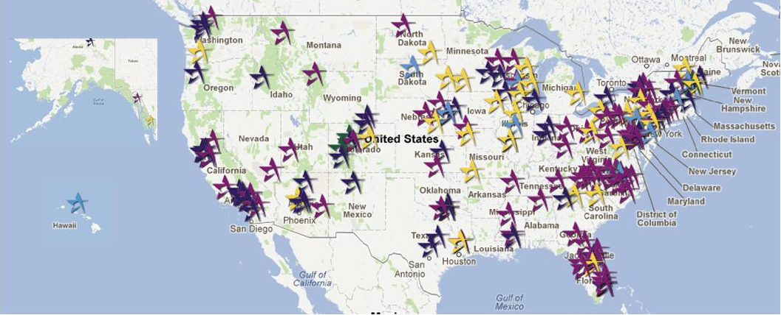
Most Comprehensive Study Ever
All 50 States + D.C.
Notes:
This study is our 4th economic impact study of the nation’s nonprofit arts and culture industry—the largest and most comprehensive of its kind ever conducted.
182 study regions . . . All 50 states + D.C.

Slide 3
Arts and the “Great Recession”
Changes between 2005 and 2010
Unemployment
5.1% to 9.7%
Consumer Confidence
101 to 54
Home Foreclosures Tripled:
885,000 to 2.9 million
Spending on recreation, entertainment, shopping:
$192 to $164 billion
Live attendance:
arts and sports
Jobs in tourism, food & beverage

Slide 4
How a Dollar is Re-Spent in a Community . . .

Slide 5
Economic Impact of Nonprofit Arts & Culture Industry
$135.2 Billion Annual Expenditures (2010)
Full-Time Equivalent Jobs | 4.1 Million
Resident Household Income | $86.7 Billion
Local Government Revenue | $6.1 Billion
State Government Revenue | $6.7 Billion
Federal Income Tax Revenue | $9.6 Billion
Notes:
$135.2 billion dollar industry . . . 4.1 million FTEs . . . $22.3 billion in government revenue
(1) Full-Time Equivalent (FTE) Jobs describes the total amount of labor employed. Economists measure FTE jobs, not the total number of employees, because it is a more accurate measure that accounts for part-time employment. (2) Resident Household Income (often called Personal Income) includes salaries, wages, and entrepreneurial income paid to local residents. It is the money residents earn and use to pay for food, mortgages, and other living expenses. Revenue to (3) Local and (4) State Government includes revenue from local and state taxes (e.g., income, property, sales, and lodging) as well as funds from license fees, utility fees, filing fees, and other similar sources.

Slide 6
Organizations Spent . . .
$61.1 Billion

Slide 7
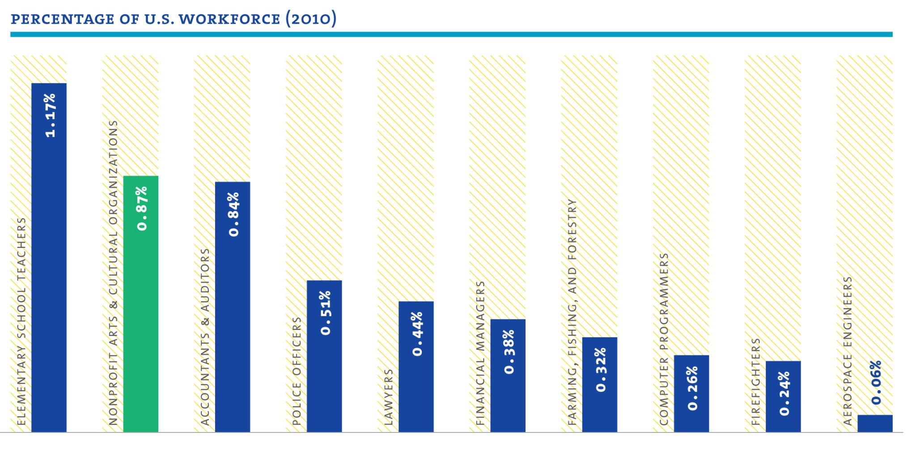
1.1 Million Jobs Supported
Directly by Nonprofit Arts Organizations
Notes:
Spending by nonprofit arts and culture organizations provide rewarding employment for more than just artists, curators, and musicians. They also directly support builders, plumbers, accountants, printers, and an array of occupations spanning many industries.
Nonprofit arts and culture organizations support more jobs than accountants and auditors, public safety officers, and even lawyers, and just slightly fewer than elementary school teachers. The above chart provides a helpful context for the large number of jobs directly supported by nonprofit arts and culture organizations. It must be noted that the arts and culture jobs represent portions of multiple industry sectors (e.g., musicians, designers, accountants, printers), whereas the comparison groups are single job classifications.

Slide 8
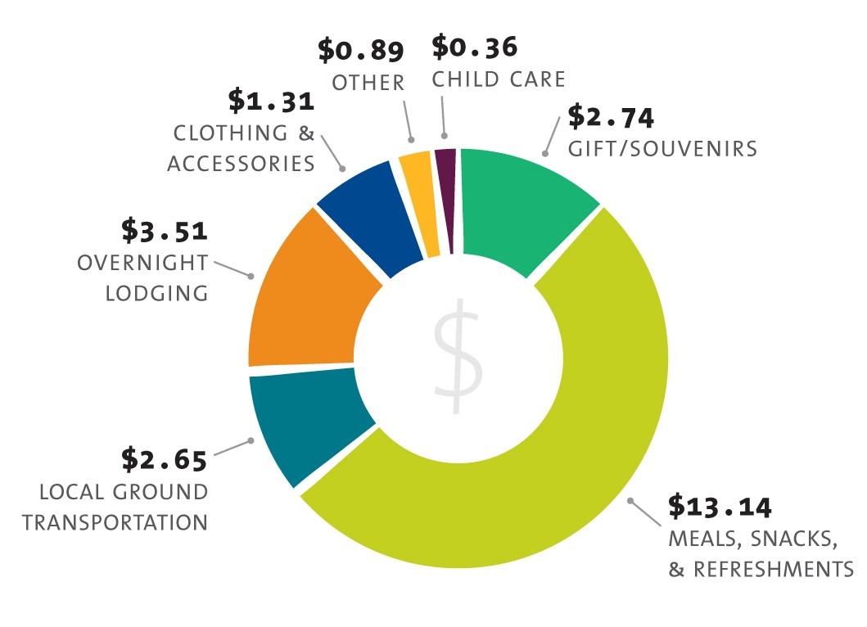
Nonprofit Arts Attendees Spend
$24.60 Per Person, Per Event

Slide 9
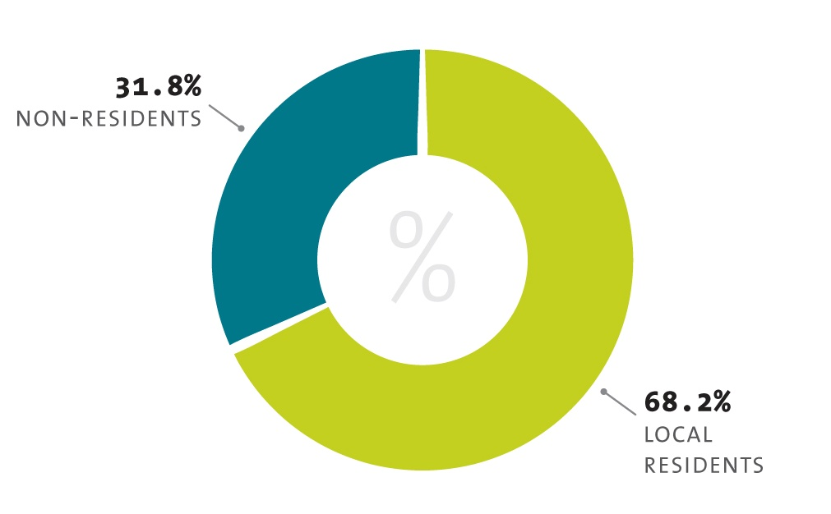
Nonprofit Arts & Culture Attendees Local vs. Nonlocal

Slide 10
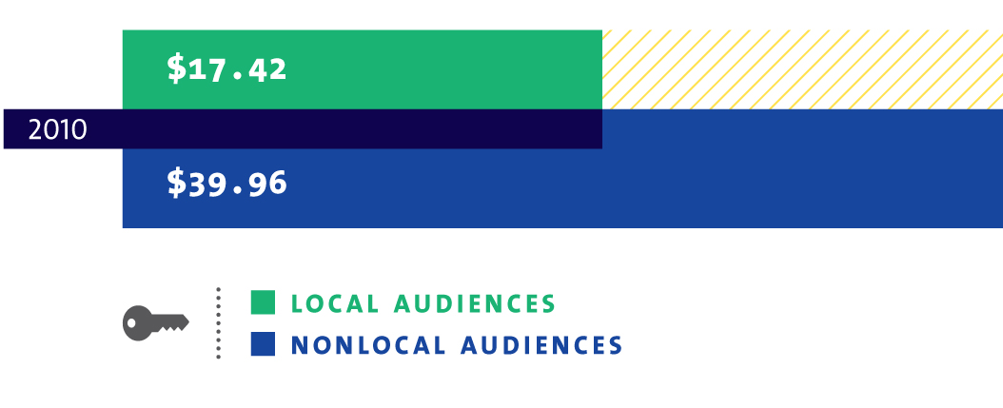
Event-Related Spending Local vs. Nonlocal Audiences
59.4 percent of nonlocal attendees said: “this arts event is their primary purpose for their trip.”

Slide 11
Will You Travel for a Cultural Experience?
Q: If this event were not happening, would you have traveled to
another community to attend a similar cultural experience?
30.8% 27.0% 29.6%
27.7% 20.6% 25.4%
41.5% 52.3% 45.0%

Slide 12
Audiences spent . . .
$74.1 Billion

Slide 13
Nonprofit Arts & Culture Industry
Organizations $61.1 Billion
Audiences $74.1 Billion
Total $135.2 Billion
Supports 4.1 million FTE jobs
Generates $22.3 billion in government revenue

Slide 14
Arts Volunteerism
Average community: 5,215 arts volunteers who donated 201,719 hours ($4.3 million value)
Average organization: 45 volunteers who donated 72 hours each
Value of 2010 volunteer hour = $21.36

Slide 15
Economic Impact of Nonprofit Arts & Culture Industry
$142.4 Million Annual Expenditures (2010) (Delaware)
Full-time equivalent jobs | 3,868
Resident Household Income | $112,337,000
Local Government Revenue | $1,704,000
State Government Revenue | $8,235,000
Notes:
$135.2 billion dollar industry . . . 4.1 million FTEs . . . $22.3 billion in government revenue
(1) Full-Time Equivalent (FTE) Jobs describes the total amount of labor employed. Economists measure FTE jobs, not the total number of employees, because it is a more accurate measure that accounts for part-time employment. (2) Resident Household Income (often called Personal Income) includes salaries, wages, and entrepreneurial income paid to local residents. It is the money residents earn and use to pay for food, mortgages, and other living expenses. Revenue to (3) Local and (4) State Government includes revenue from local and state taxes (e.g., income, property, sales, and lodging) as well as funds from license fees, utility fees, filing fees, and other similar sources.
14

Slide 16
Nonprofit Arts & Culture Industry
Organizations $103.4 Million
Audiences $ 38.9 Million
Total $142.3 Million
Supports 3,868 FTE jobs
Generates $9.9 million in government revenue

Slide 17
Local vs. Nonlocal Attendees in Delaware
Notes:
***These slides can be customize for your local community!!!***
(To customize this chart for your community: select the chart area, go to the “design” tab, and select “edit data.” Then insert your community’s local findings)

Slide 18
Event-Related Spending Local vs. Nonlocal Audiences
79.2 percent of nonlocal attendees said: “this arts event is their primary purpose for their trip.”
Notes:
***These slides can be customize for your local community!!!***
(To customize this chart for your community: select the chart area, go to the “design” tab, and select “edit data.” Then insert your community’s local findings)

Slide 19
Delaware Attendees Spent
$29.80 Per Person, Per Event
Notes:
***These slides can be customize for your local community!!!***
(To customize this chart for your community: select the chart area, go to the “design” tab, and select “edit data.” Then insert your community’s local findings)
For organizational data . . .
Each community studied, and thus these national estimates, are based only on data reported. No local estimates made for non-respondents.

Slide 20
Will You Travel for a Cultural Experience?
Q: If this event were not happening, would you have traveled to
another community to attend a similar cultural experience?
30.8% 27.0% 29.6%
27.7% 20.6% 25.4%
41.5% 52.3% 45.0%
(National results)

Slide 21
Arts Volunteerism in Delaware
13,270 volunteers donated 596,036 hours in 2010 ($12.7 million value)
Average organization: 44.9 volunteers who donated 152.5 hours each
Value of 2010 volunteer hour = $21.36
Notes:
***These slides can be customize for your local community!!!***
(This data can be found in Table 13 of Appendix B of the full Arts & Economic Prosperity IV statistical report)

Slide 22
Personal Arts Creativity Experiences
Q: Do you actively participate in the creation of art
(e.g., sing in a choir, act in a play, paint or draw)?
Notes:
***These slides can be customize for your local community!!!***
(To customize this chart for your community: select the chart area, go to the “design” tab, and select “edit data.” Then insert your community’s local findings)

Slide 24
Notes:
***These slides can be customize for your local community!!!***
(To customize this chart for your community: select the chart area, go to the “design” tab, and select “edit data.” Then insert your community’s local findings)
23
Delaware State Arts Council Presentation
September 19, 2012

Slide 28
Arts & Economic Prosperity IV
6 Take-Aways for Delaware
$142.3 million industry
Supports 3,868 jobs (among top 10 DE employers)
Generates $9.9 million in local/state revenue
Attendees spend $29.80 per person (beyond admission)
Resilient in tough economic times
If arts aren’t available here, patrons will go elsewhere

Slide 29
National AEP4 Research Partners

Slide 30
The Arts Mean Business! www.AmericansForTheArts.org/EconomicImpact

